Slide 1
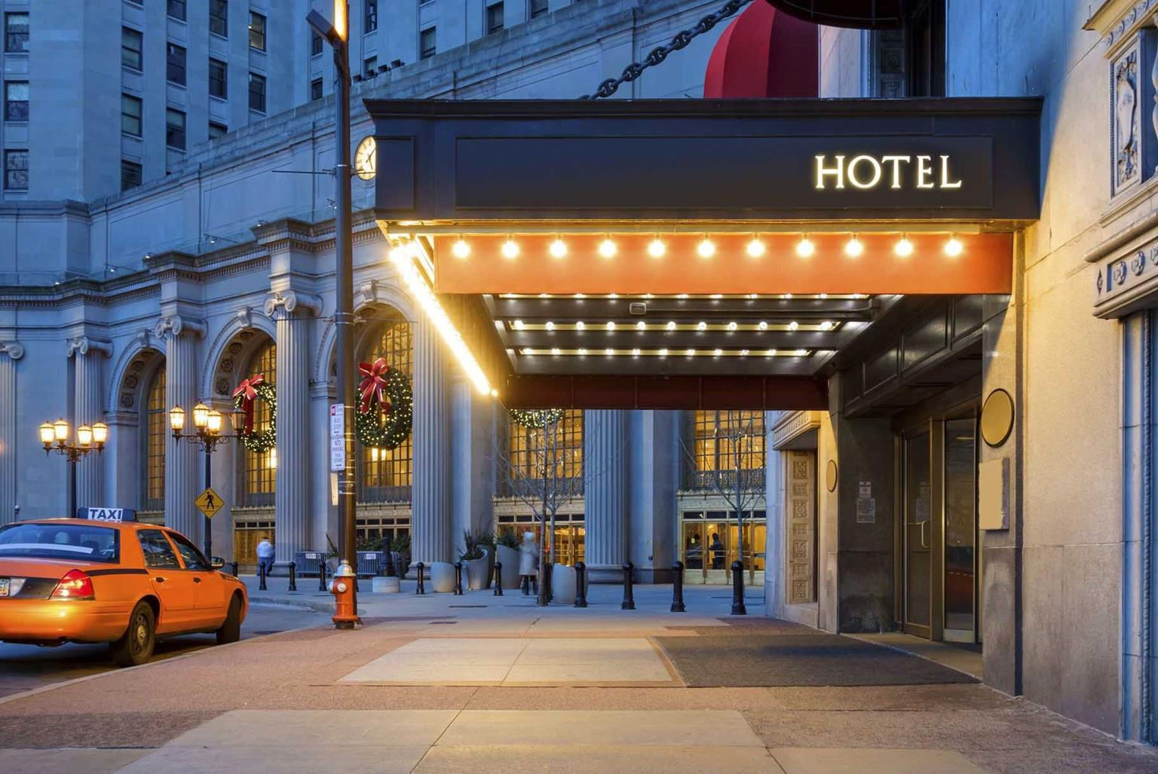
Hotel Reservation System
1

Slide 2

Agenda
Softwares used
Packages and Plugins used
SQLITE DataBase used
Application Features
GITHUB
DOCKER

Slide 3
Feasibility in Project Proposal
User Login
Staff/Admin Login
General Home Page
Room Availability Details
Booking Form - User and Admin
All Booking Details/Stats for Admin
Add New Hotel Location to DB for Admin
Add New Room Details to DB for Admin
Logout
Reference Link
https://realpython.com/search?q=hotel+management+system

Slide 4


Objective of Reservation System
Skip the Queue
Avoid the last minute chorus
Meet traveler expectations
The main motive is to avoid the long waiting queues
Ensure Guest have the smooth check in process
To avoid running out of the rooms at last minute

Slide 5


Advantages of Reservation System
Increased Efficiency
24/7 Accessibility
Enhanced Customer Experience
Reduced Workload for Staff
Improved Accuracy
Data Management and Analytics

Slide 6






Softwares Applications/Frameworks Used
Pycharm Professional IDE
SQLite - Database
GitHub
Docker
Python Flask

Slide 7
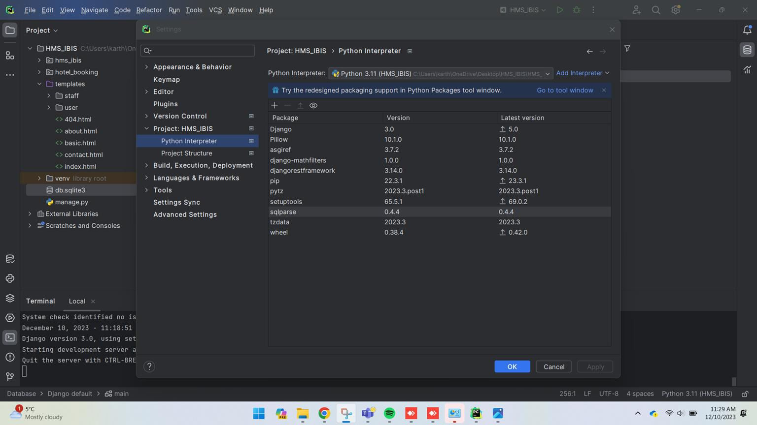
Major Packages Used
We have used: Django, Django-mathfilters, Djangorestframework, Pillow

Slide 8
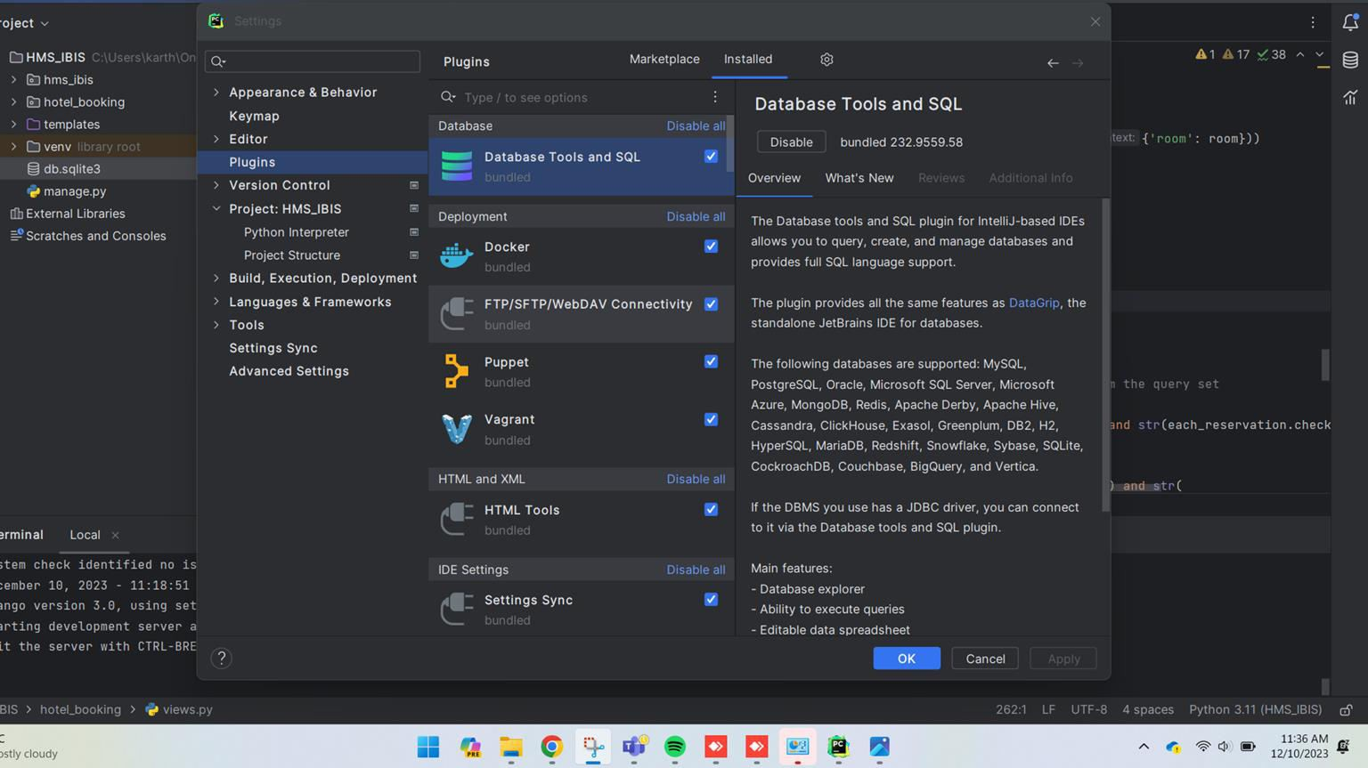
Database Plugin
Database plugin - Database Tools and SQL is used for accessing the SQLIte database

Slide 9

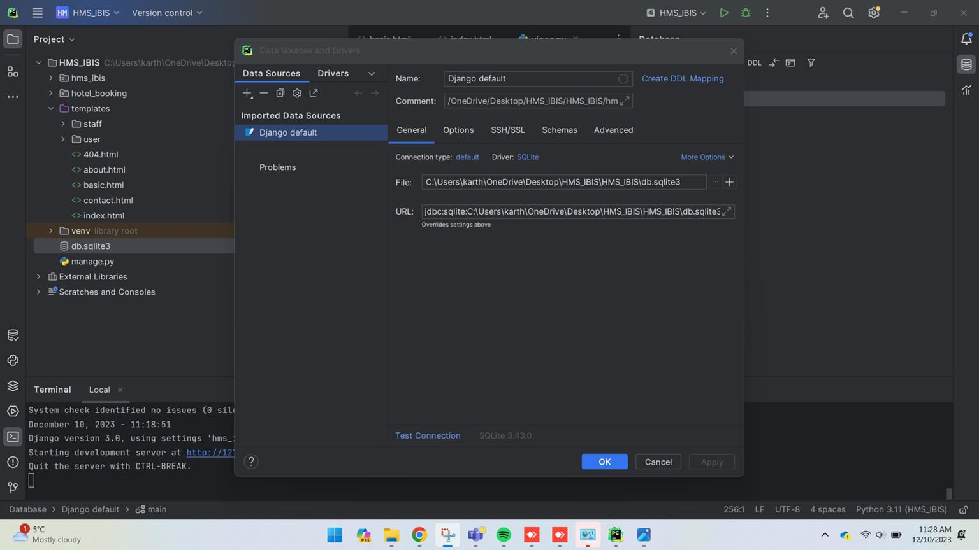
SQLite Database
SQLite is a database engine written in the C programming language. It is not a standalone app; rather, it is a library we have embedded in the Pycharm

Slide 10
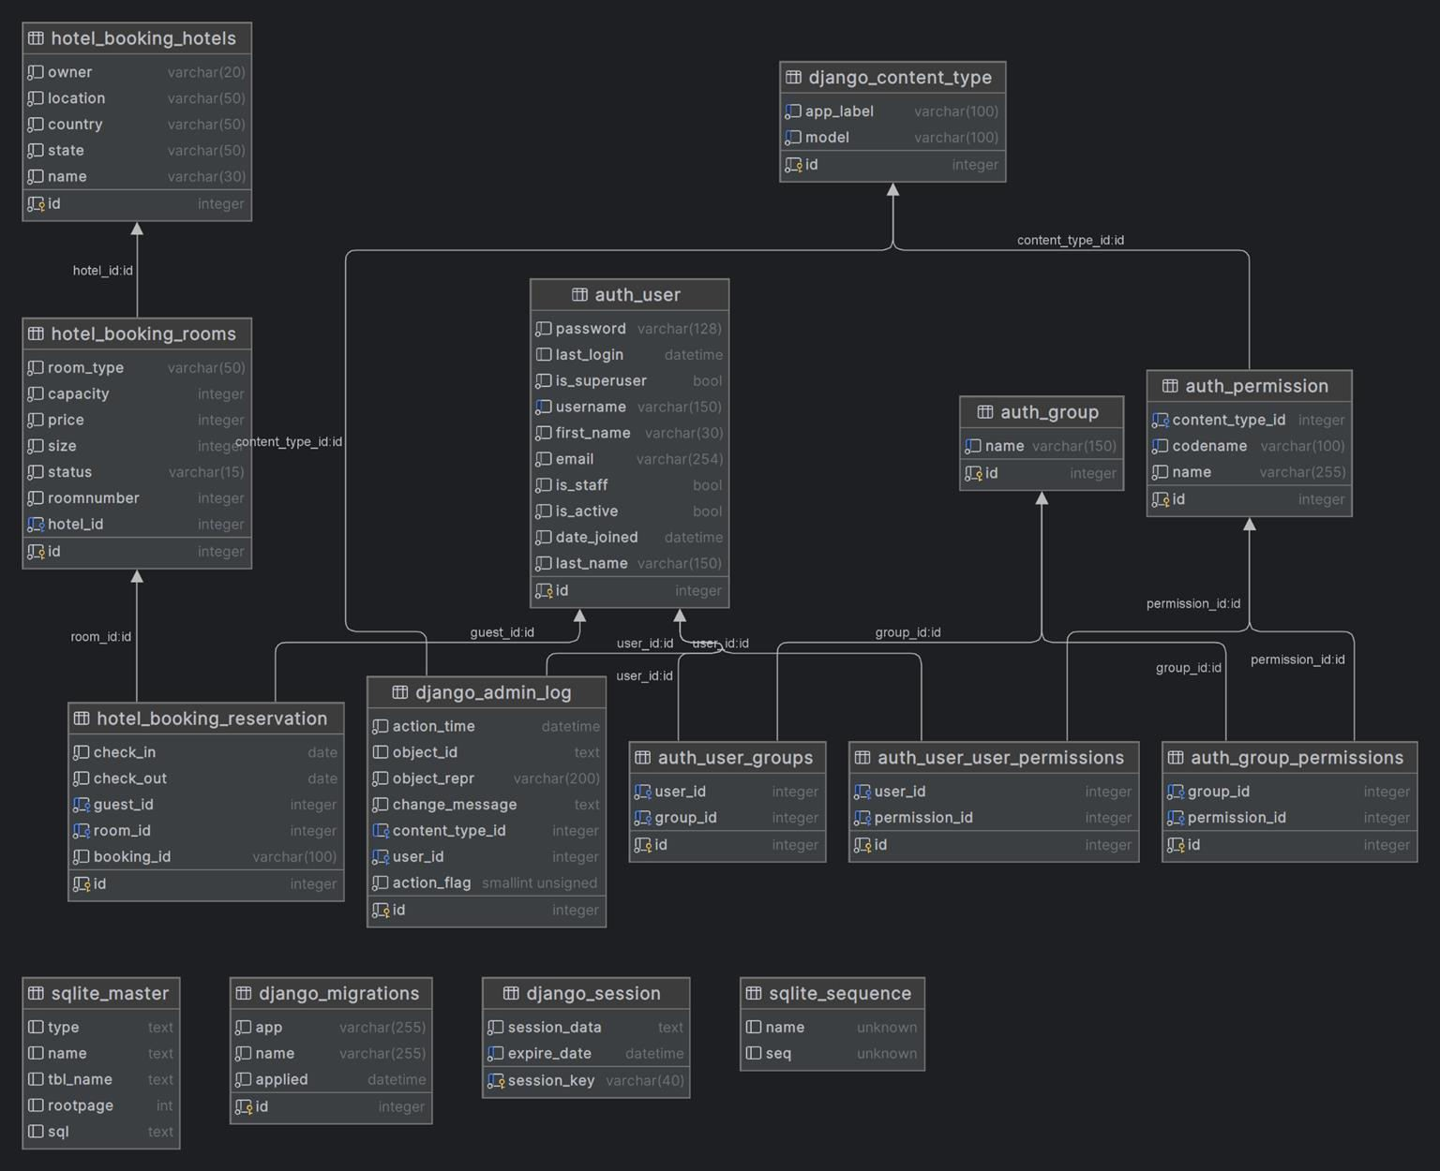
Database Schema
A database schema refers to the logical and visual configuration of the entire relational database.
The database objects are often grouped and displayed as tables, functions, and relations.
A schema describes the organization and storage of data in a database and defines the relationship between various tables.

Slide 11

Home Page
Home page has the following features
User Login
Admin/Staff Login
Search Room Availability based on the Location
With Check-In, Check-Out and Person Count
Room Details Information with Images
Information includes the
Price
Size
Capacity
Services included
View

Slide 12
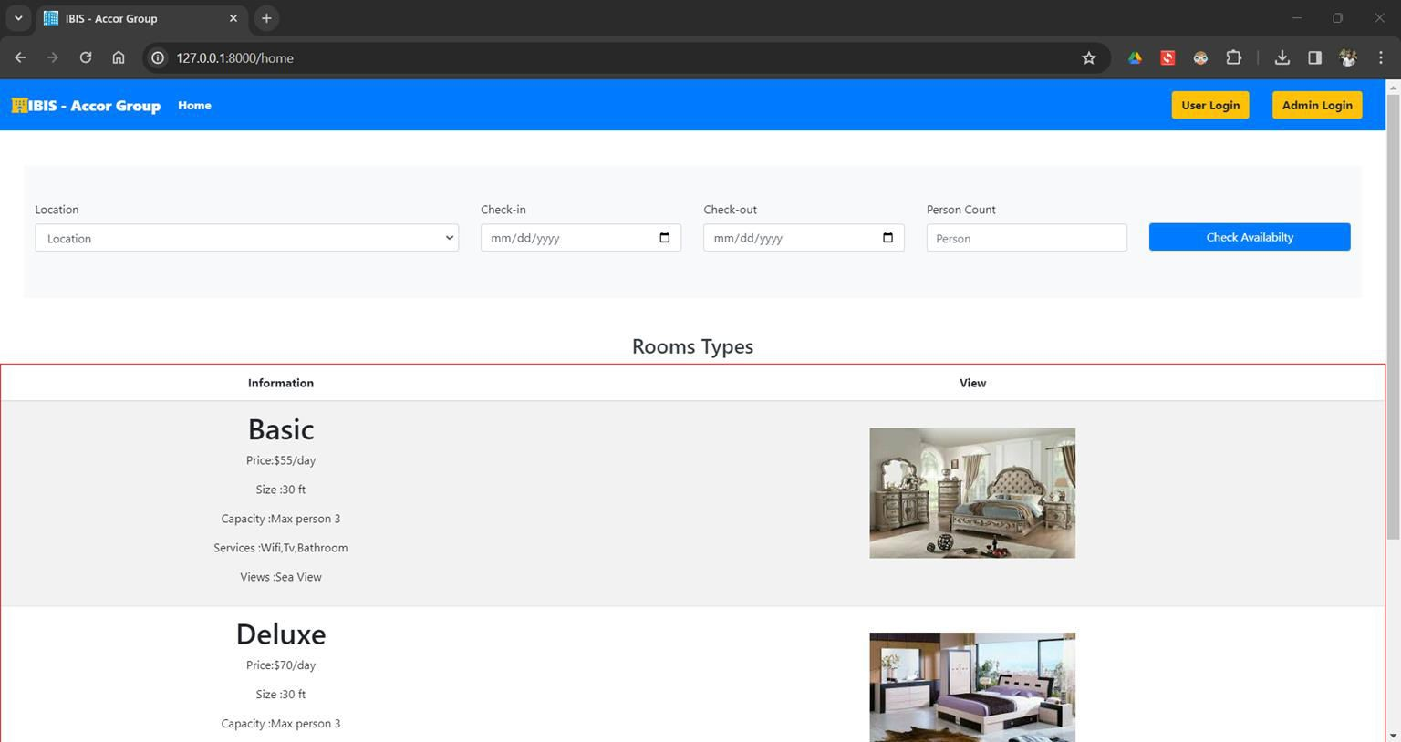
Home Page (1)

Slide 13
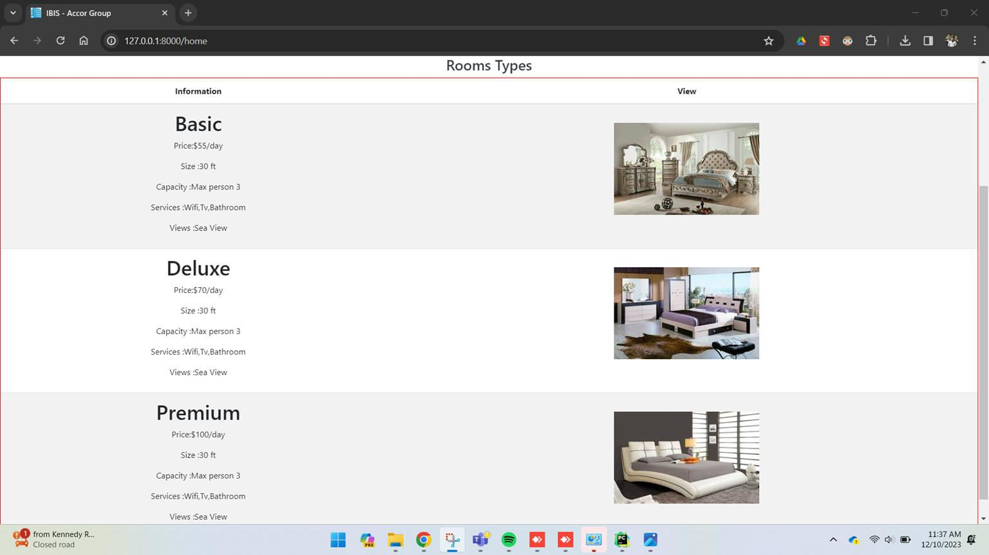
Home Page (2)

Slide 14
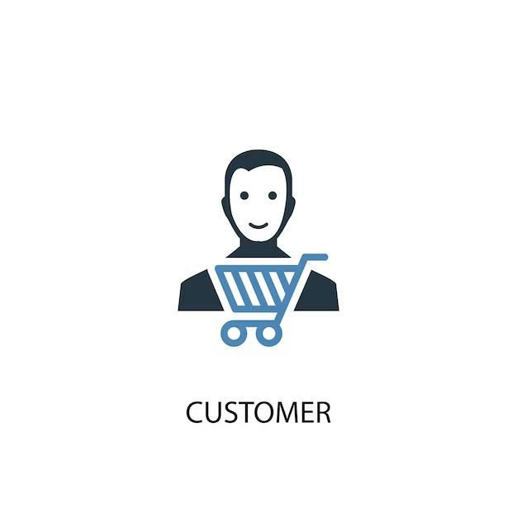
User Role and Features

Slide 15

User SignUp Page Features
User Sign Up page has the following features
UserName
Password
Confirm Password
Validations:
Username Validation: Check for the existing username when new user
is created.
Password & Confirm Password: Checks for the given password and confirm password match when new user is created.

Slide 16
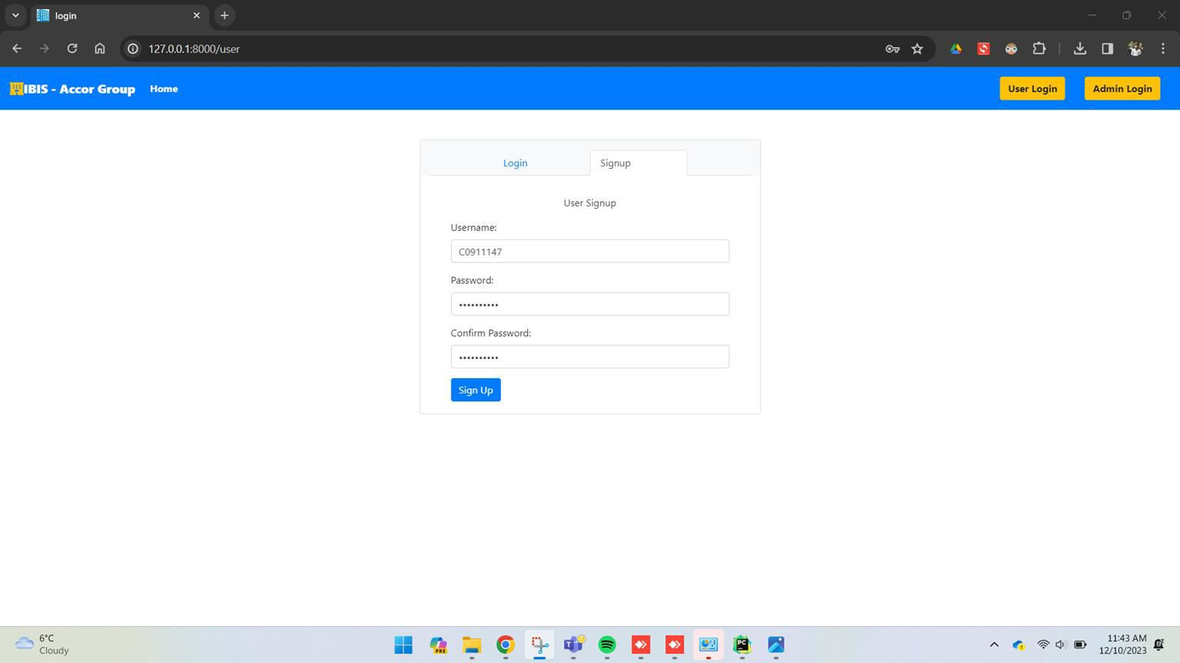
User SignUp Page (1)

Slide 17
User SignUp Page (1)

Slide 18
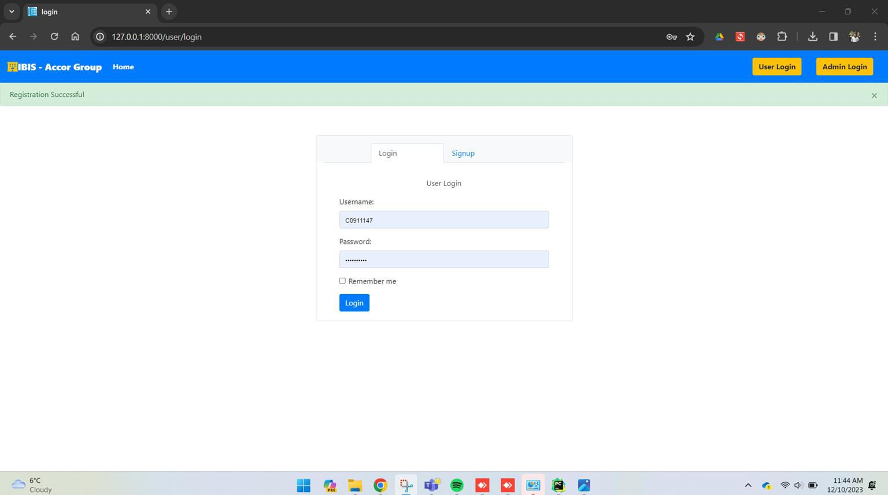
User Login Page (2)

Slide 19
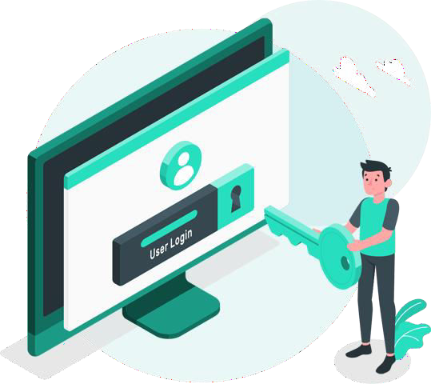
User - Login Page Features
User Login page has the following features
UserName
Password
Validations:
Username & Password Validation: Checks for the input username and password with the existing username and password in database and allows/denies the user to login accordingly.

Slide 20
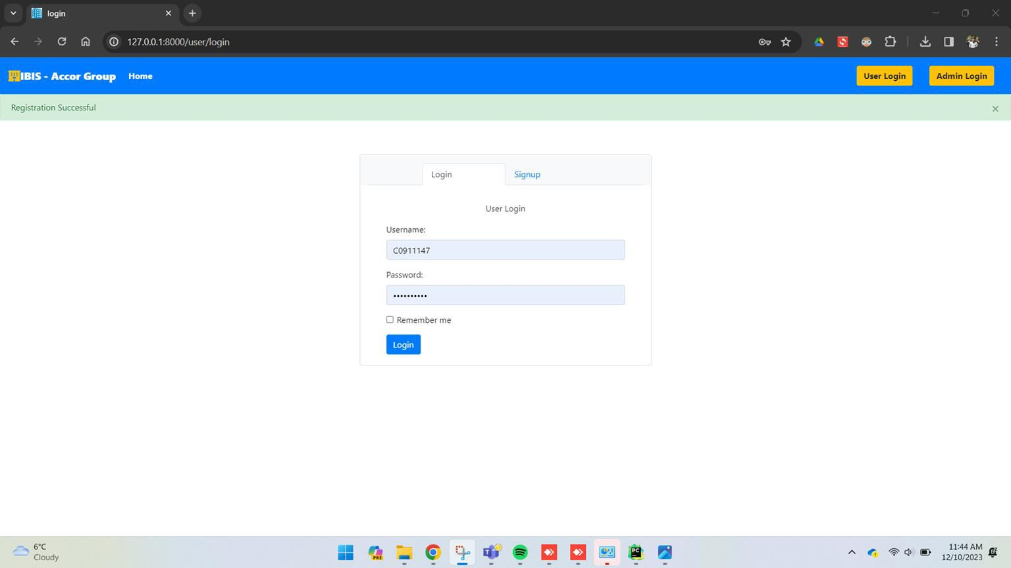
User - Login Page (1)

Slide 21
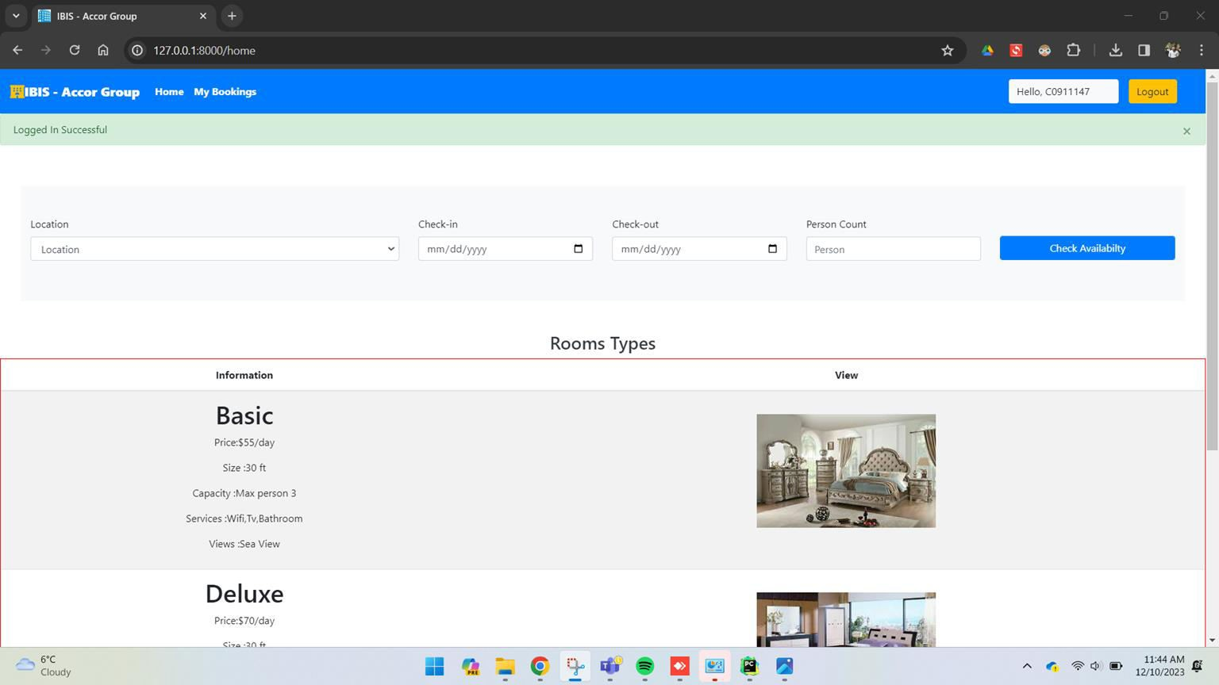
User - Login Page(2)

Slide 22
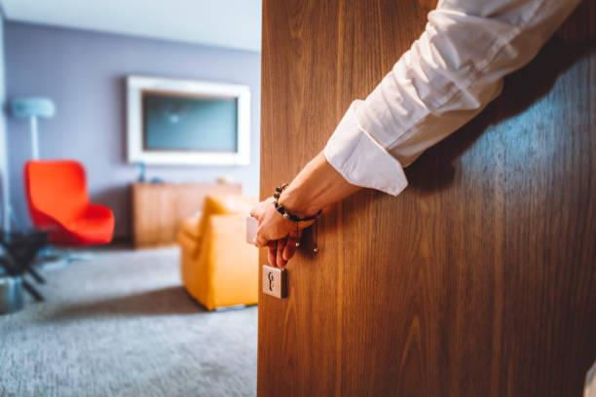
Room Search Feature
Room Search in Home Page has the following features
Select Location (Hotel Location)
Check - In Data
Check - Out Date
Number of Persons
Validations:
Minimum Person Count/Room - 1
Maximum Person Count/Room - 3
All Input values are mandatory, if not given will throw the mandatory
field error

Slide 23

Room Search Feature Validation (1)

Slide 24
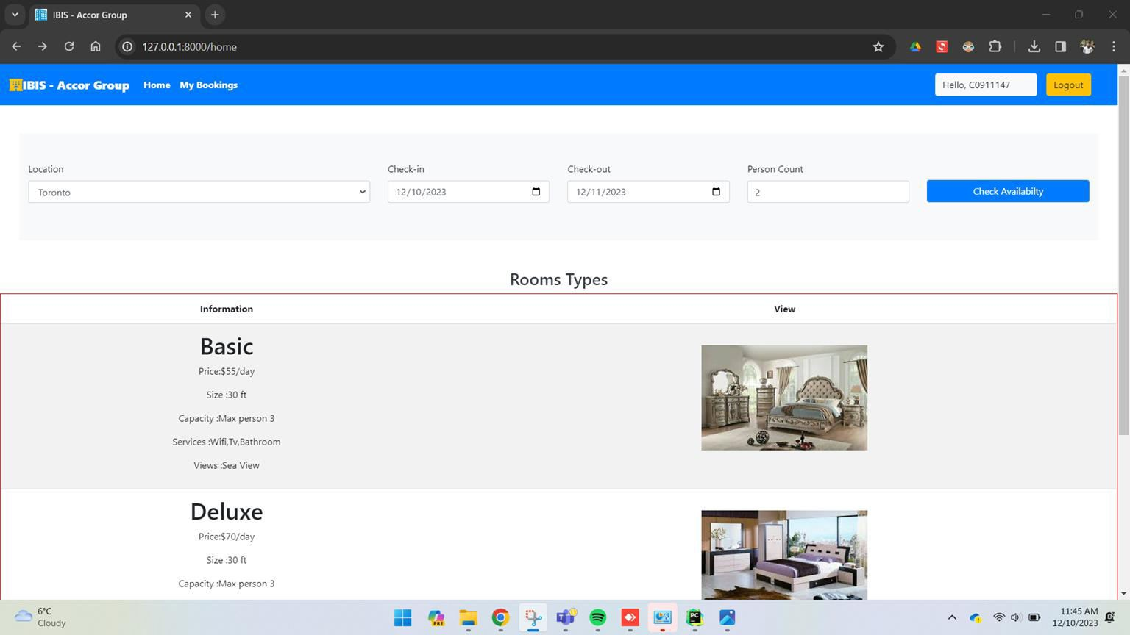
Room Search Feature(2)

Slide 25

Room Search Result Feature
Room Search Result in Home Page has the following results
Room Type
Location
Person
Price
Action ( Book Now)
Result List:
It will have the list of the available rooms with the above mentioned
details based on the search input
It will enable the option - Book Now, if the rooms are available for the given input.

Slide 26
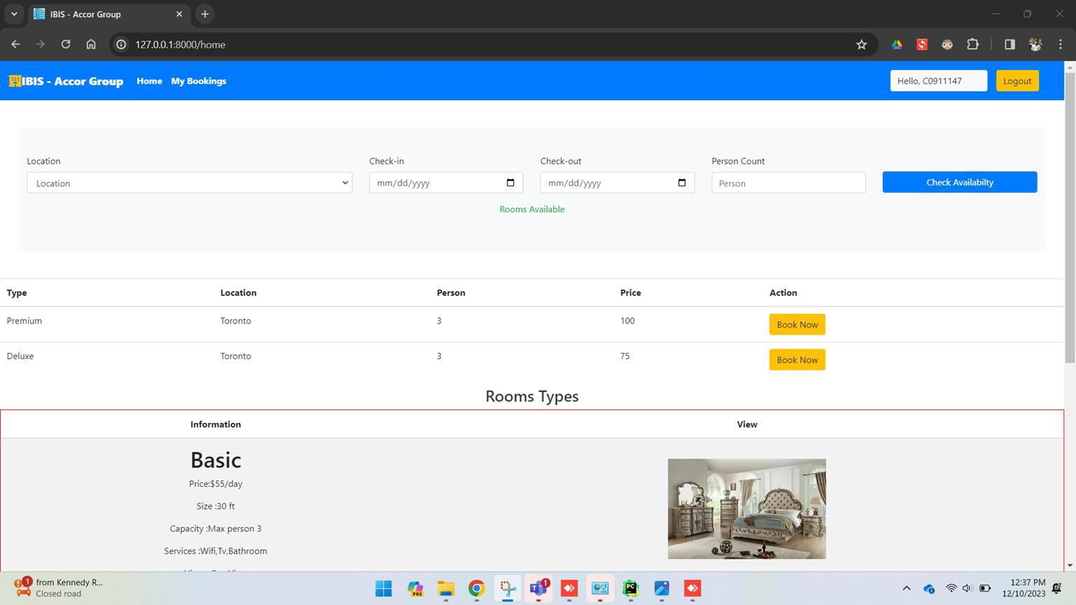
Room Search Result Feature(1)

Slide 27
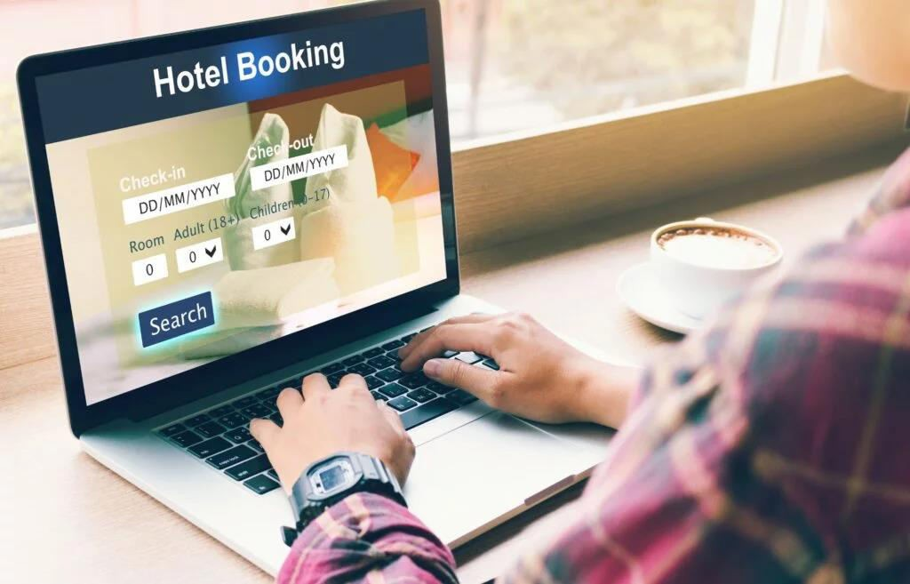
User - Room Booking Form
Room booking form has the following features.
Based on the search input and the result selection, the booking form will be
pre-filled with the given details.
Room Type
Location
Hotel
Price
Changeable fields include
Guest Name
Person Count
Check - In
Check - Out

Slide 28
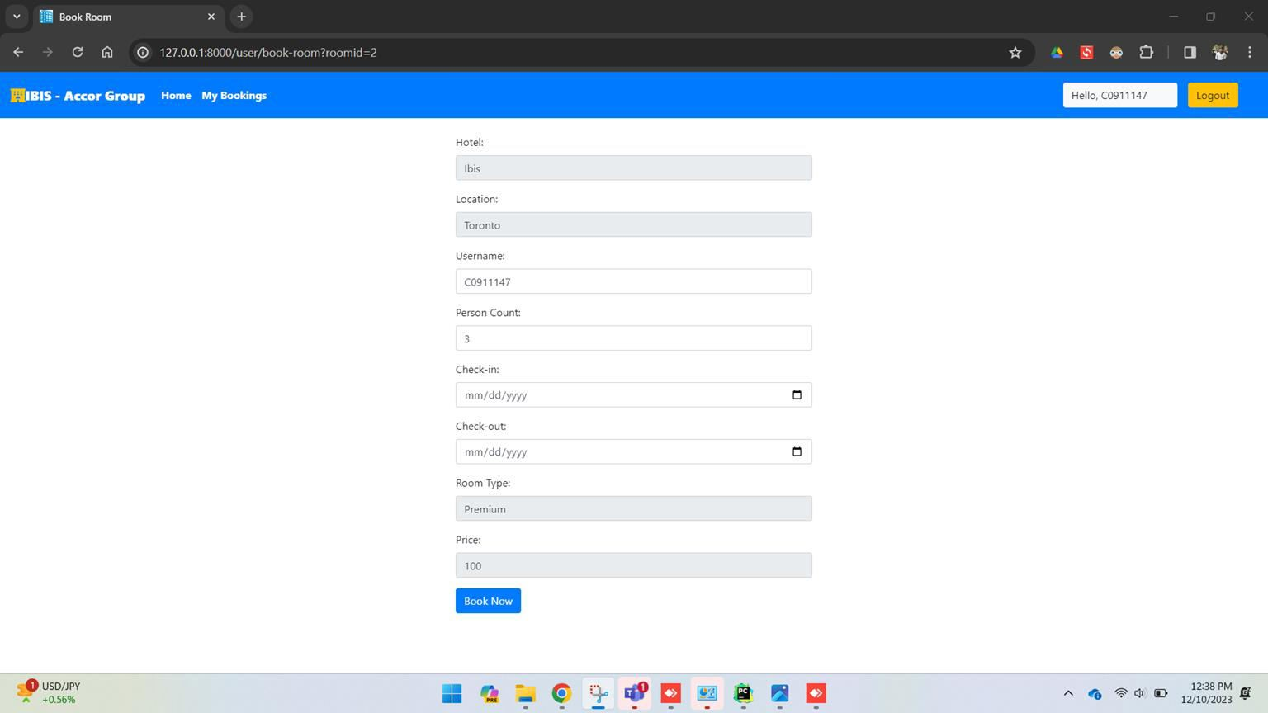
User - Room Booking Form

Slide 29

User - My Bookings Feature
User My Bookings page has the following feature
List all the bookings Customer made so far
List of details in My Bookings Feature:
User
Room
Location
Number of Persons
Check-In Date
Check-Out Date
Price

Slide 30
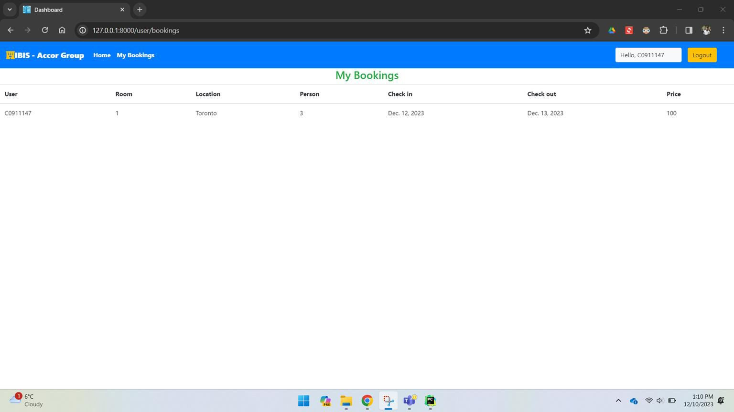
User - My Bookings Feature

Slide 31

User - LogOut Feature
User LogOut page has the following features
User Login
Admin Login
Other details same as home page
Validations:
A message will be displayed stating that LogOut is successful

Slide 32
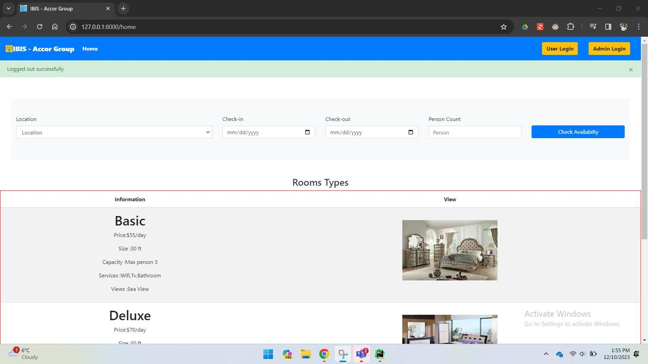
User - LogOut Feature

Slide 33

Admin Role and Features

Slide 34

Admin/Staff SignUp Page
Admin/Staff Sign Up page has the following features
UserName
Password
Confirm Password
Validations:
Username Validation: Check for the existing username
when new staff is created.
Password & Confirm Password: Checks for the given password and confirm password match when new user is created.

Slide 35
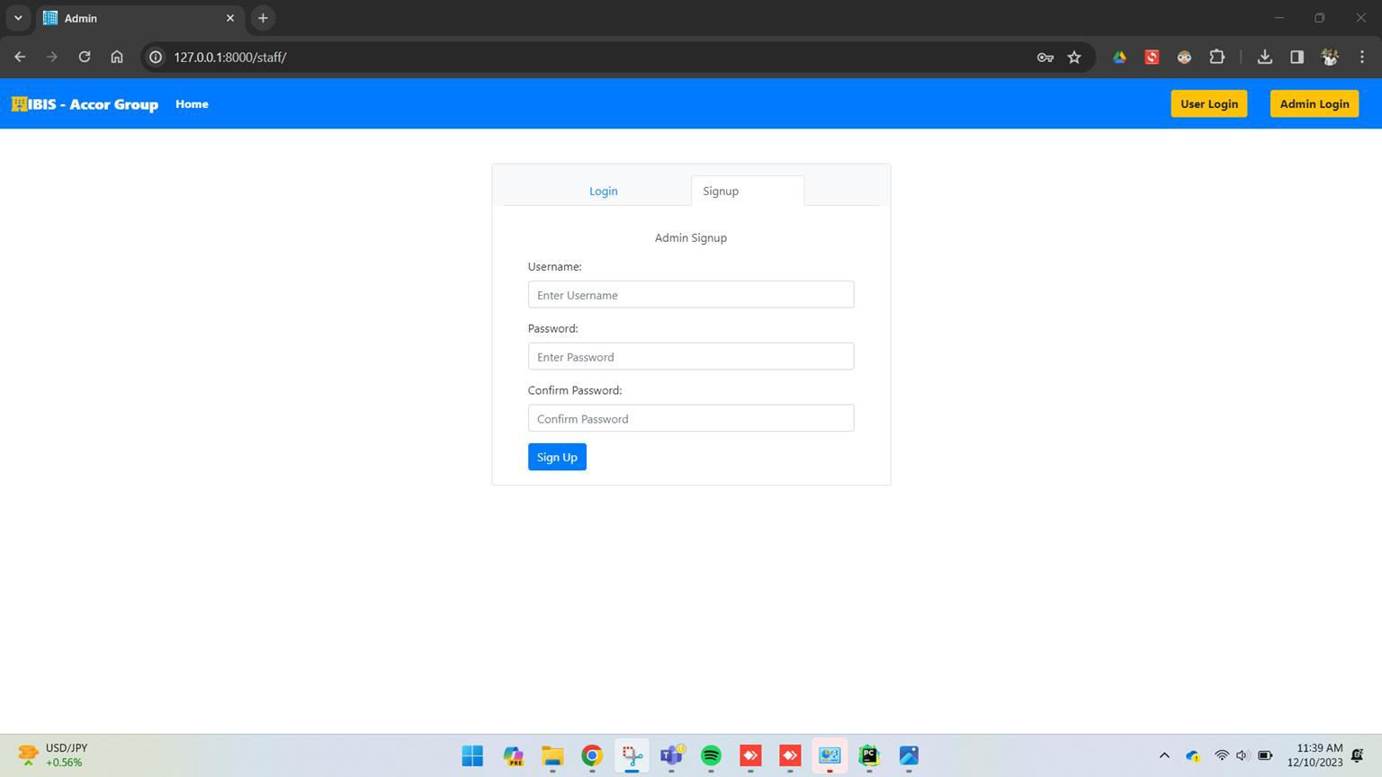
Admin/Staff SignUp Page

Slide 36

Admin/Staff Login Page
User Login page has the following
features
UserName
Password
Validations:
Username & Password
Validation: Checks for the input staff name and password with the existing staff name and password in database and allows/denies the admin/staff to login accordingly.
36

Slide 37
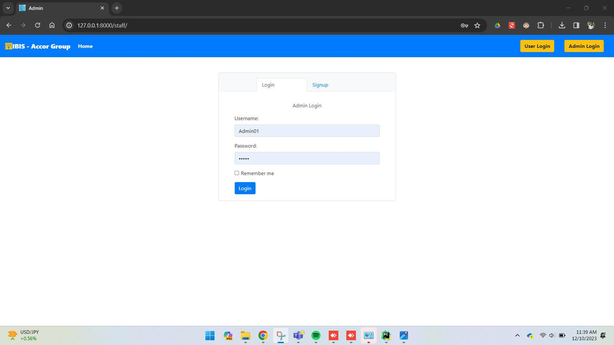
Admin/Staff Login Page

Slide 38
Admin Dashboard- All Booking Stats/Details Feature
Admin dashboard has the following features
Room Stats: The room stats displays the count of total, available, not available and reserved rooms
Room Details: Two main functions can be performed i.e..,
Add new room Add new location
Other details regarding room has been displayed.

Slide 39
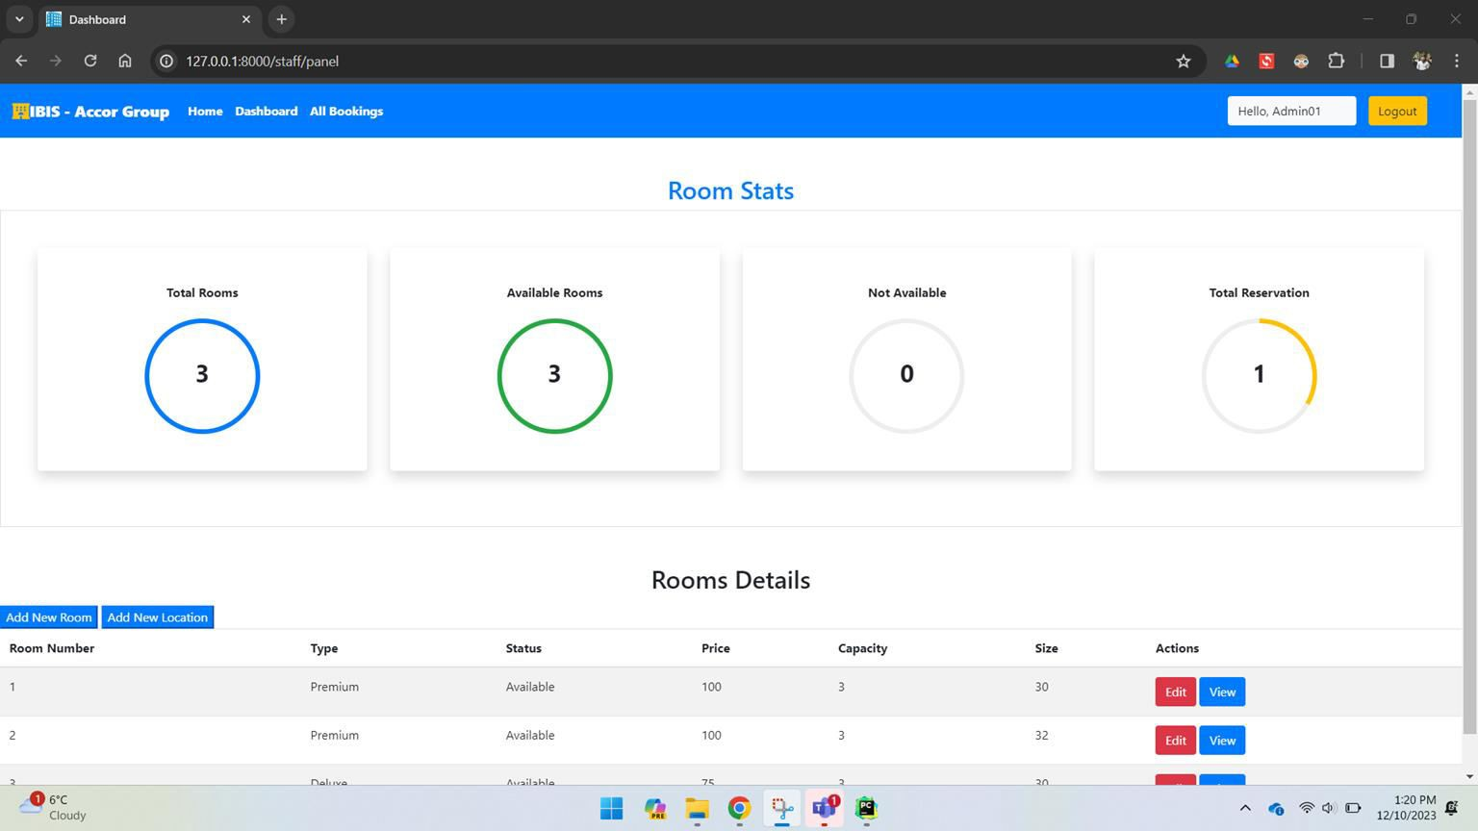
Admin Dashboard- All Booking Stats/Details Feature

Slide 40

Admin - Add Location Feature
Add New Location Feature has the following fields
Owner
City
State
Country

Slide 41
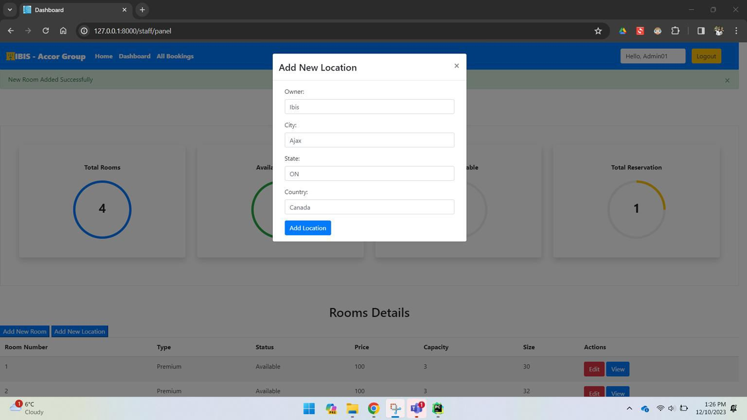
Admin - Add Location Feature(1)

Slide 42
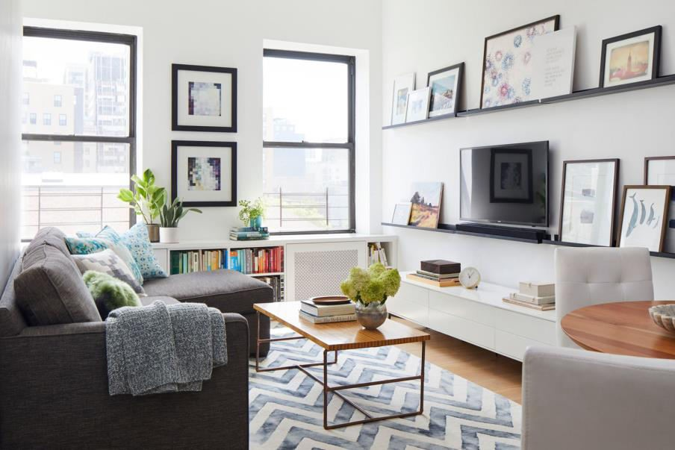
Admin - Add Room Feature
Add Room Feature has the following fields
Room Type
Capacity
Price
Size
Status
Location

Slide 43
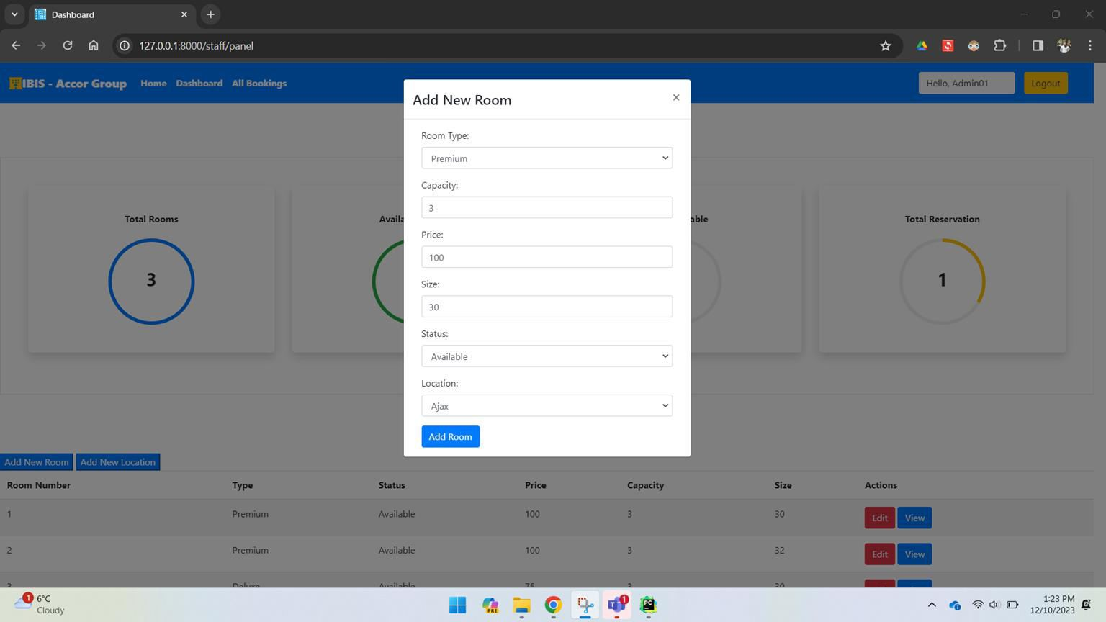
Admin - Add Room Feature(1)

Slide 44
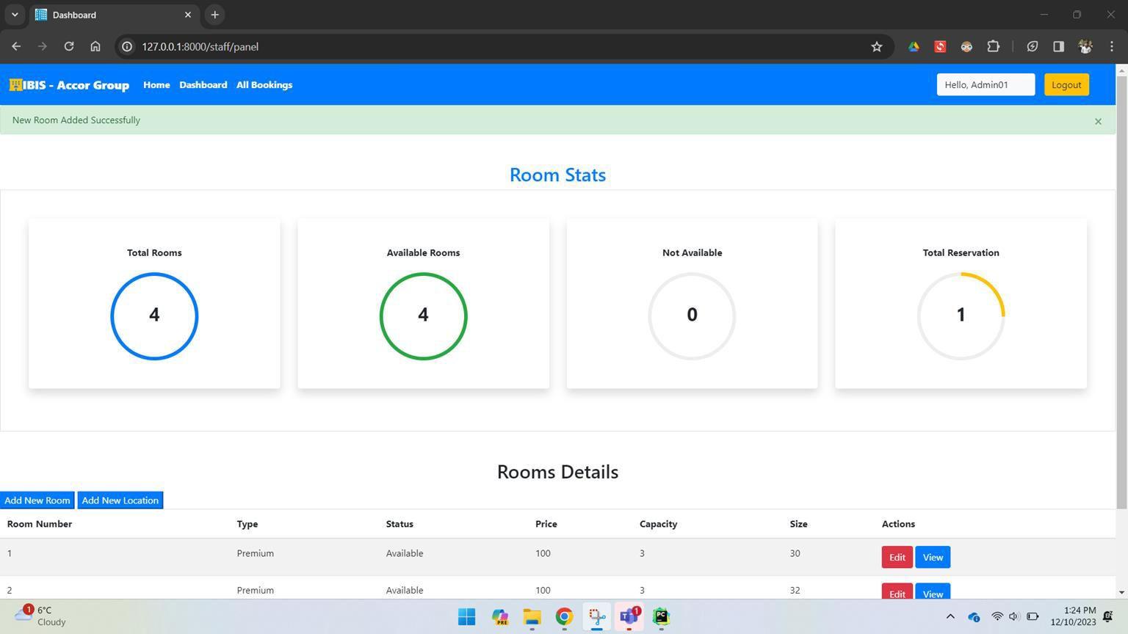
Admin - Add Room Feature(2)

Slide 45

Admin - Edit Room Feature(1)
Edit Room Feature has the following fields
Room Number
Room Type
Price
Size
Status
Location

Slide 46
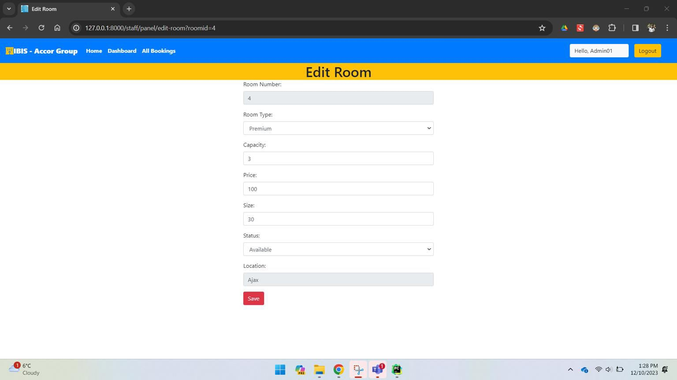
Admin - Edit Room Feature

Slide 47
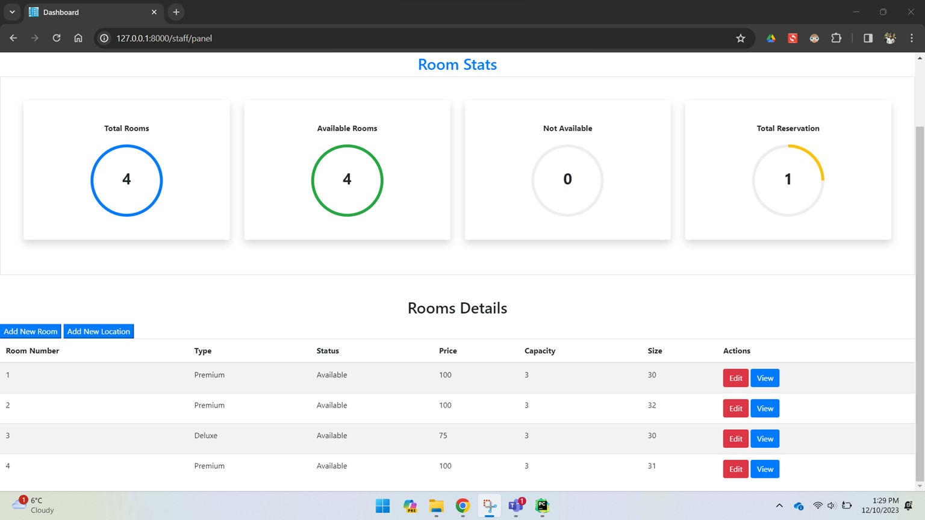
Admin - Edit Room Feature(2)

Slide 48

Admin - All Bookings
Shows every reservation
made by users.
Displays all of the booking details Info of User:
User ID
Room Number
Location
Persons Count
Check-in Time
Check-out Time
Price

Slide 49
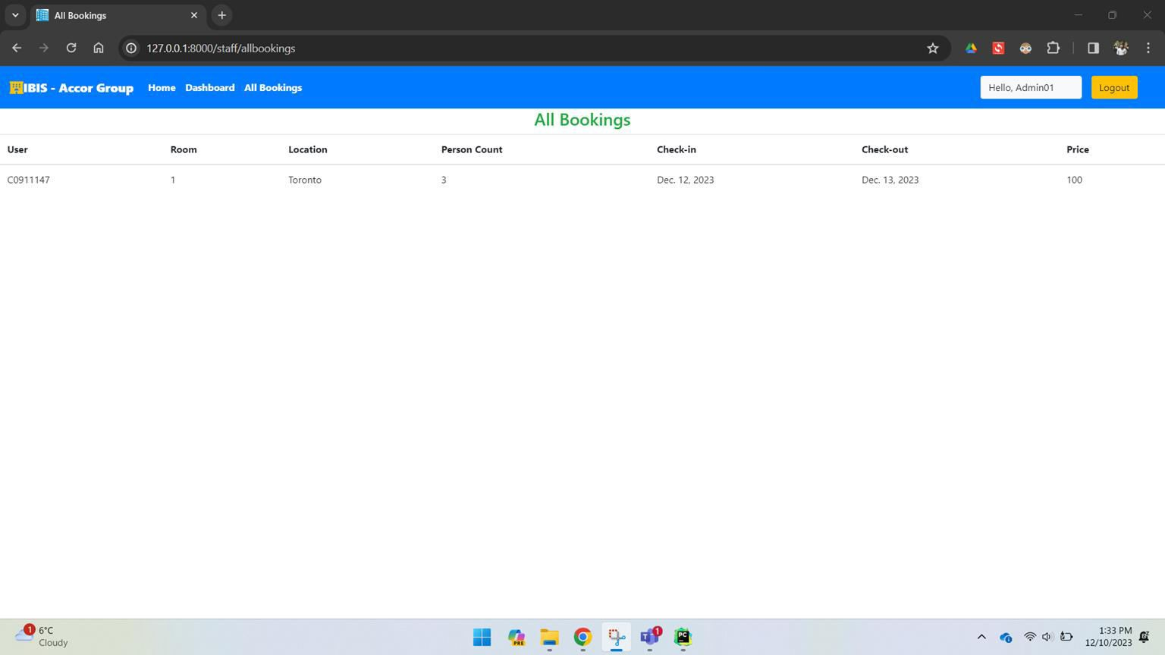
Admin - All Bookings(1)

Slide 50

Admin - Logout Feature
Logout Feature logs out by saving the information
related to bookings.
This page returns to the homescreen page.
Logout feature is available for both admin and
user.

Slide 51
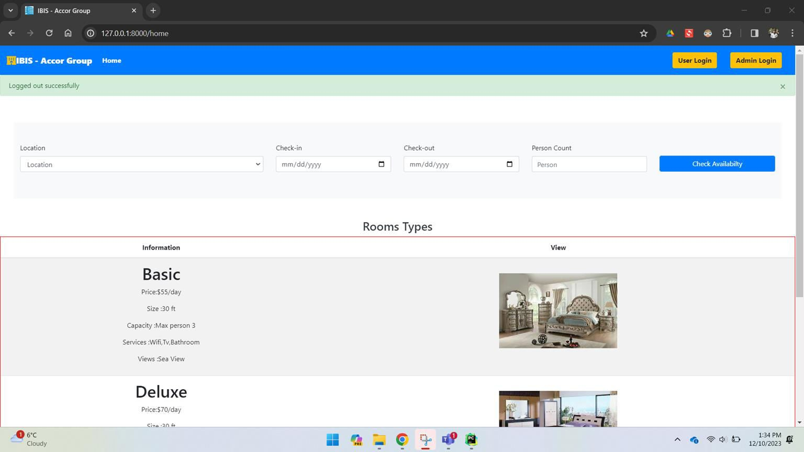
Admin - Logout Feature

Slide 52
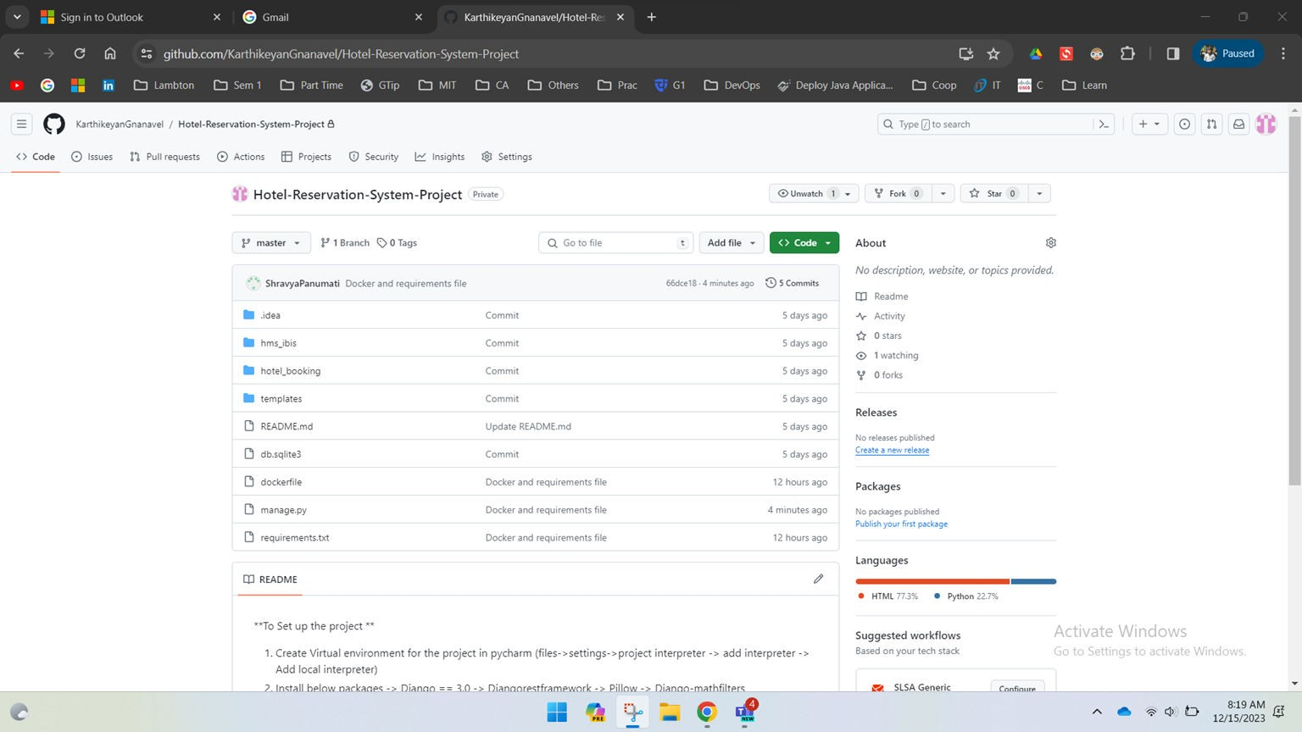
DevOps Tools - GitHub

Slide 53
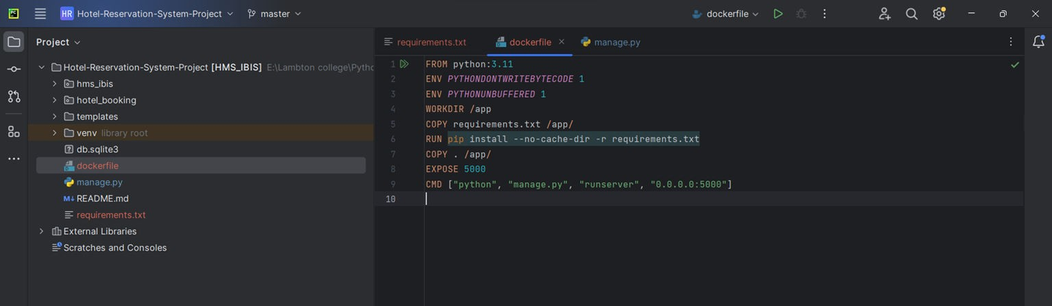
DevOps Tools - Docker
Docker File

Slide 54
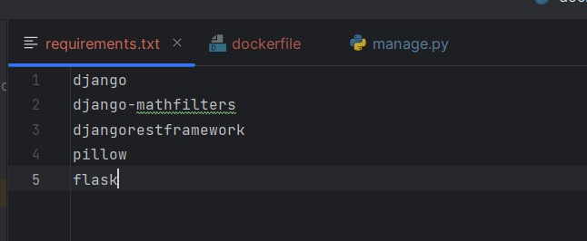
DevOps Tools - Docker
Requirements.txt

Slide 55
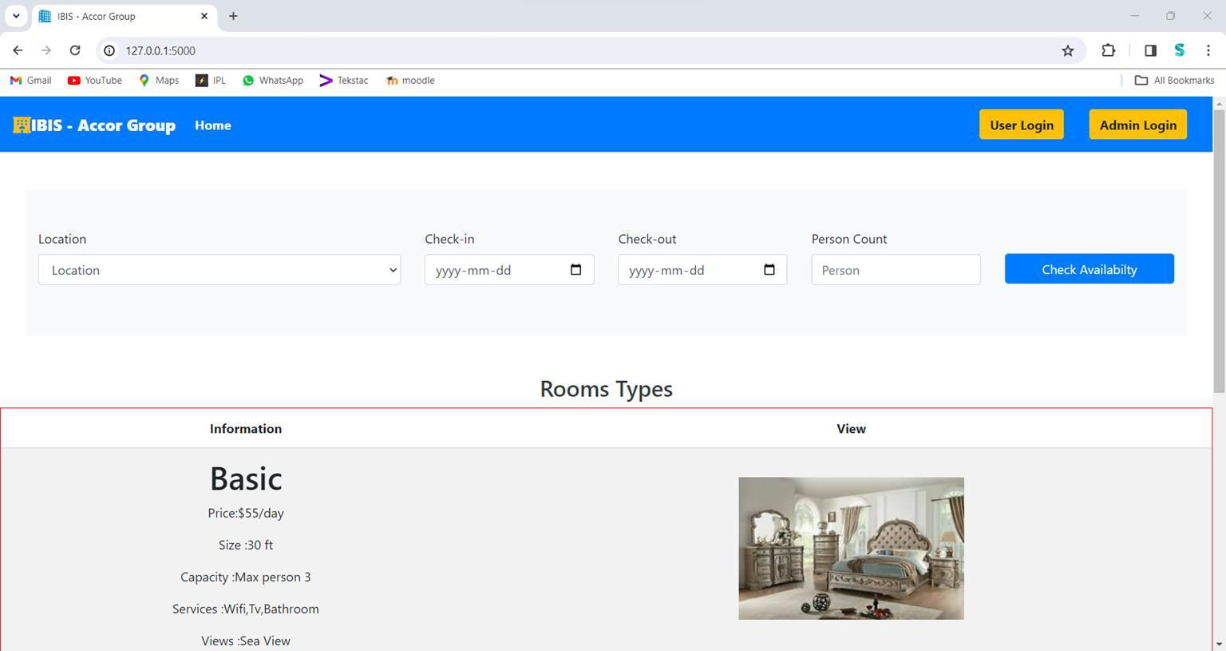
DevOps Tools - Docker Hosted Web App

Slide 56
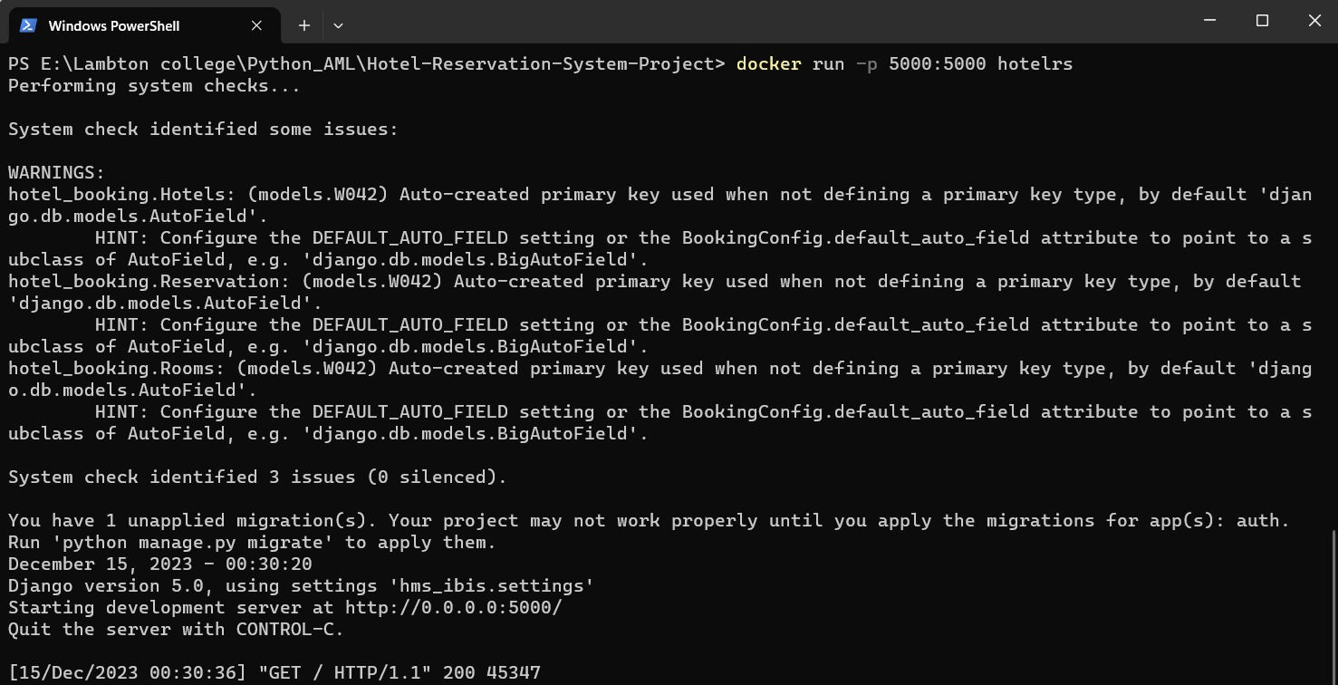
DevOps Tools - Docker

Slide 57
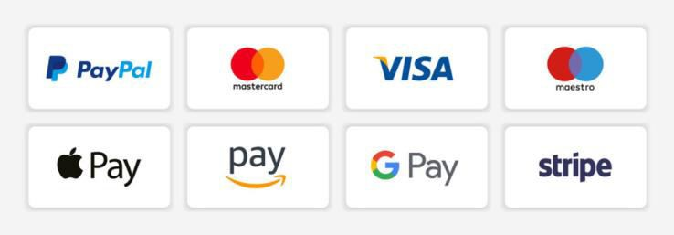



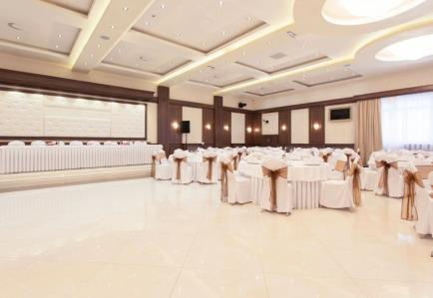
Upcoming/Planned Enhancements
Adding Payment Option
Email based authentication
Adding Loyalty Points Program
Include Shuttle Booking Services
Customise the Room booking packages
Party and Banquet Hall Booking
In room and Hotel Dining Ordering Features
Payment option with Multi Currency Option

Slide 58


